Slide 1
Developing ChatBot 2-3 ABOUT API.AI
Refresh-Foods Inc.
Yestin Yehoon Lee

Slide 2
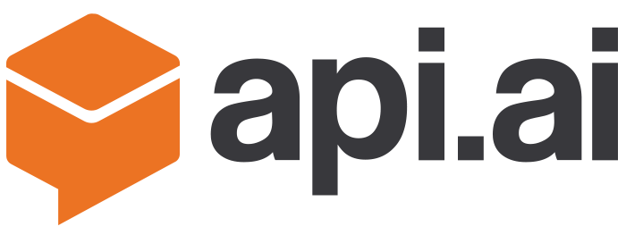

API.AI
Can process natural language
Use machine learning (analyze user’s intent)
Can apply to many platform
Easy to add/edit conversation

Slide 3
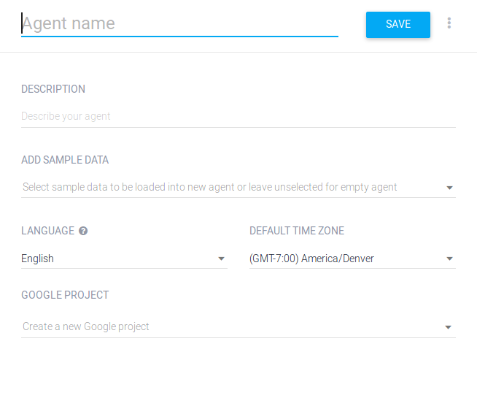
Create Agent
We are NOT going to use Google project.

Slide 4
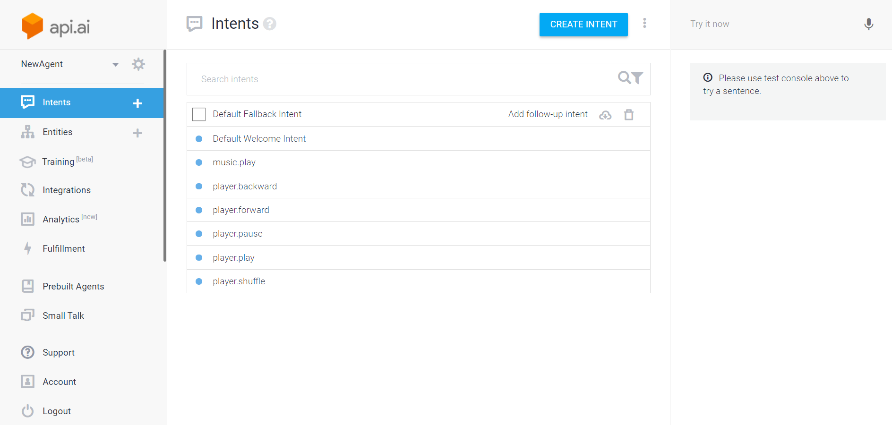
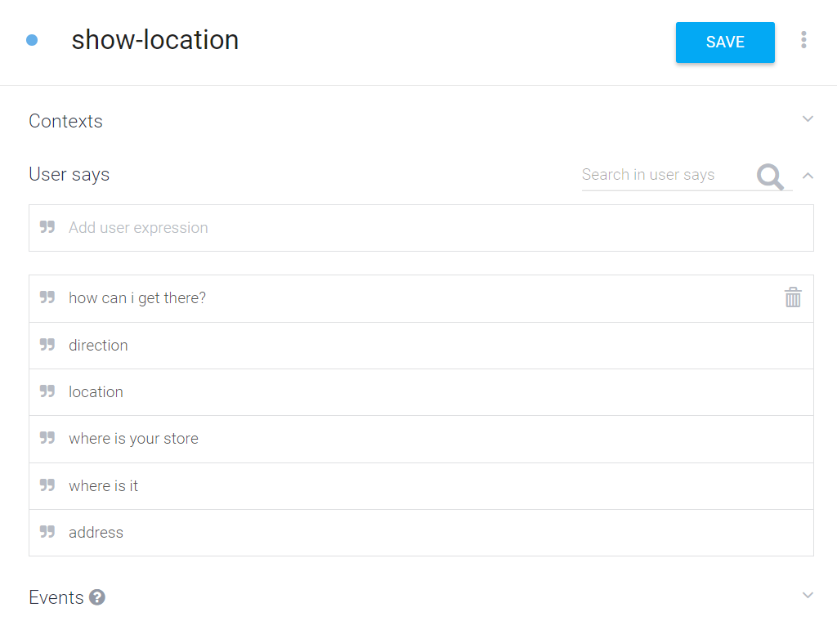
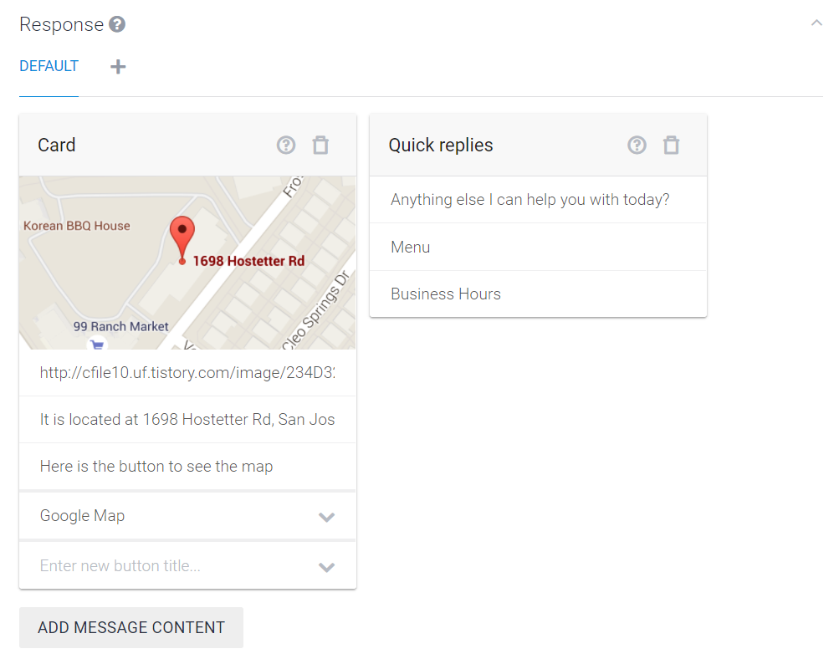
Create Intent
Question
Answer
Notes:
Go to console
Create intent
Design question and answer to the question
Answer can be multiple part.
Including image, web site, button, …

Slide 5
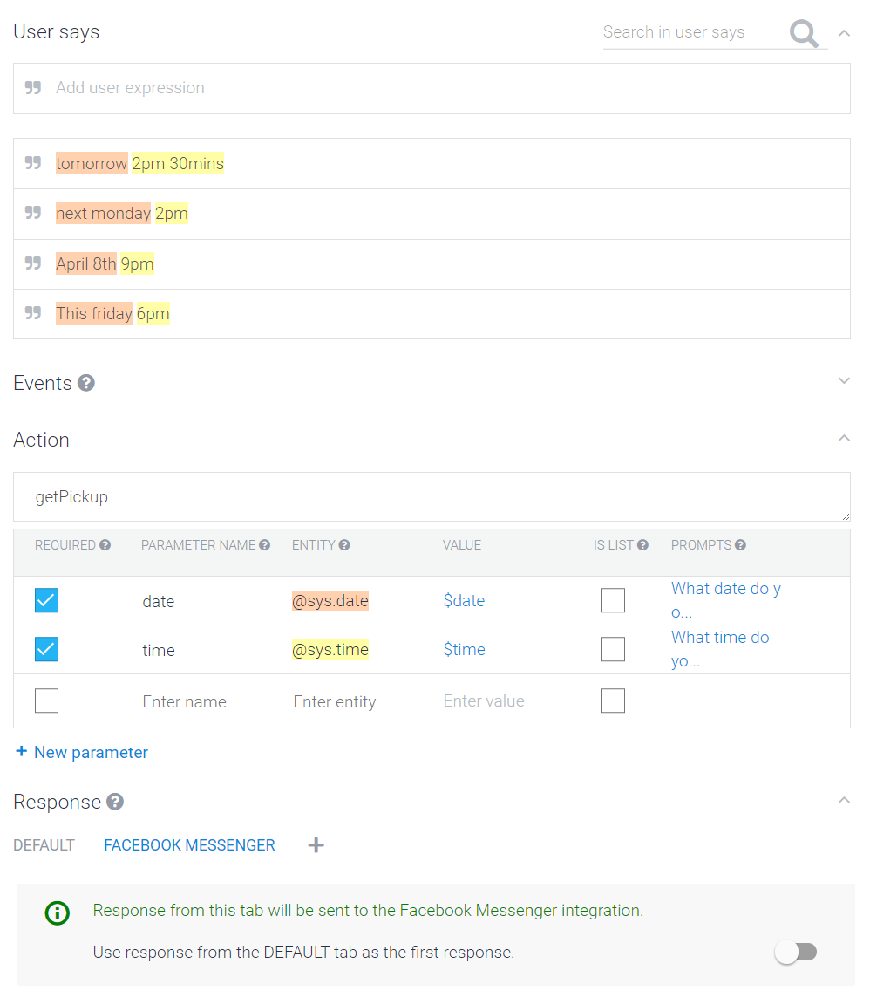
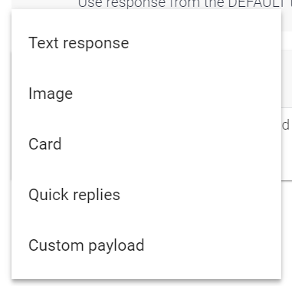
Match Parameters
API.AI recognize: time, date, location …
Fallback – no matched answer to the question
Type of responses
Notes:
Luckily, API.AI smartly recognize most of important concept
Fallback – when input not matched by already exist intent

Slide 6
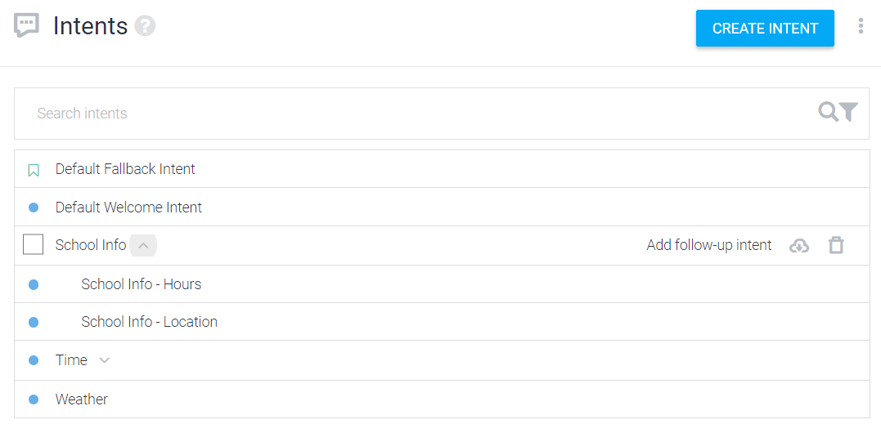
Followup Intent
Used for conversation flow
ex)
A: Are you a human?
B: Yes. (If you say no, it doesn’t go to female question)
A: Are you female?
B: No.

Slide 7
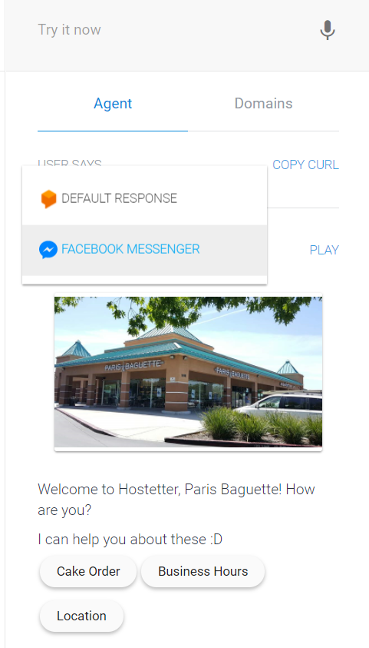
Testing
Select platform

